Slide 1
How to Develop and Communicate Whole Grain Health Messages
Caroline Sluyter
Program Director, Oldways Whole Grains Council
Working Group Chair & Governing Board Member, Whole Grain Initiative

Slide 2
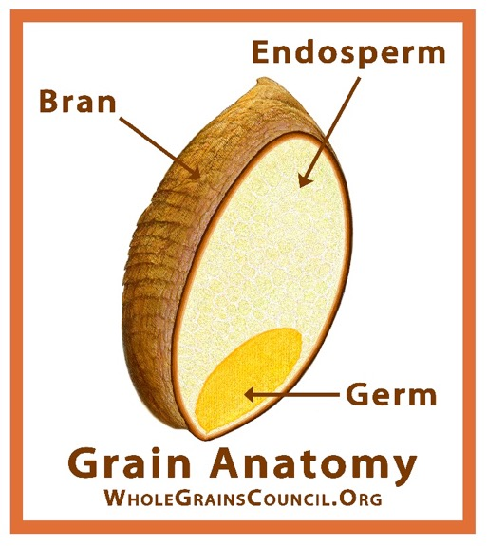
About the Oldways Whole Grains Council
Our three-part mission:
To help consumers find whole grain foods and understand their health benefits
To help manufacturers and restaurants create delicious whole grain foods
To help the media write accurate and compelling stories about whole grains

Slide 3
Our Communication Model

Slide 4




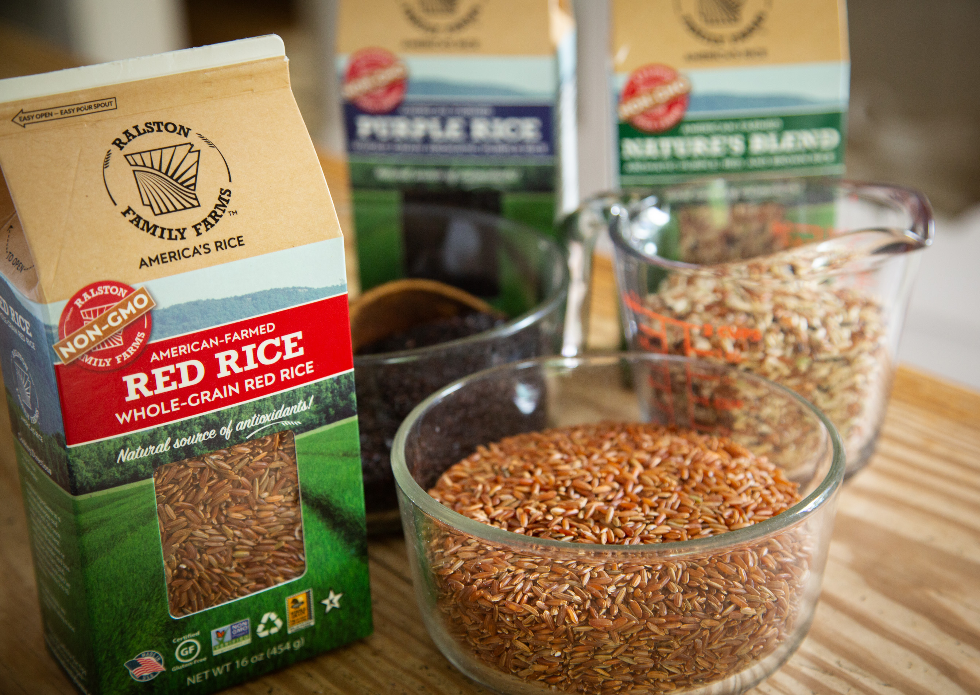


Annual Whole Grain Events
A Whole Day for Whole Grain – End of March
Whole Grains Month – September

Slide 5
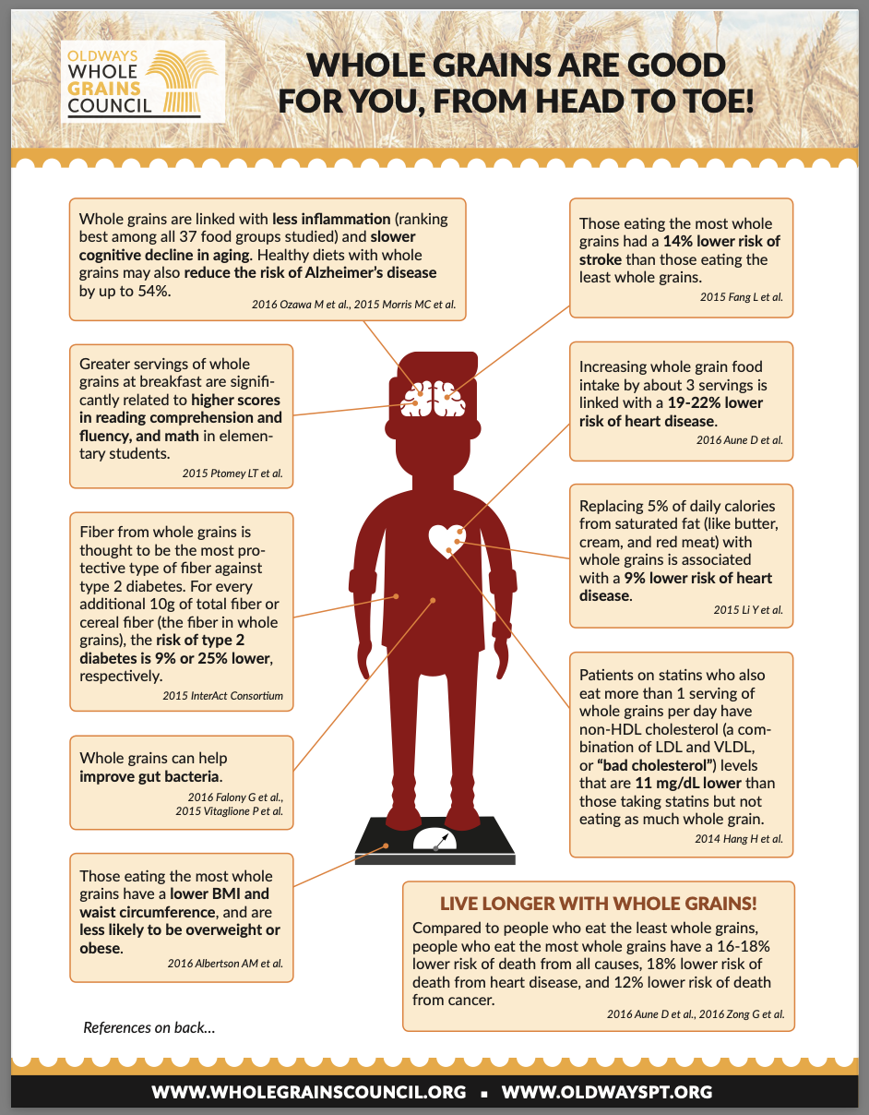
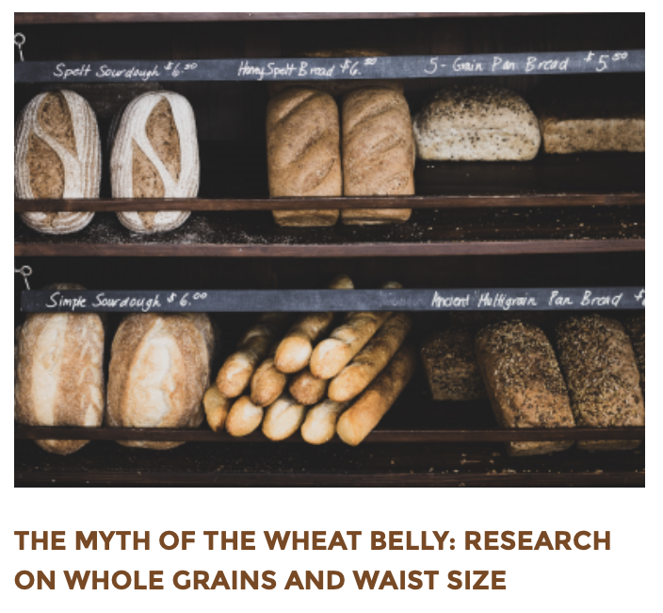

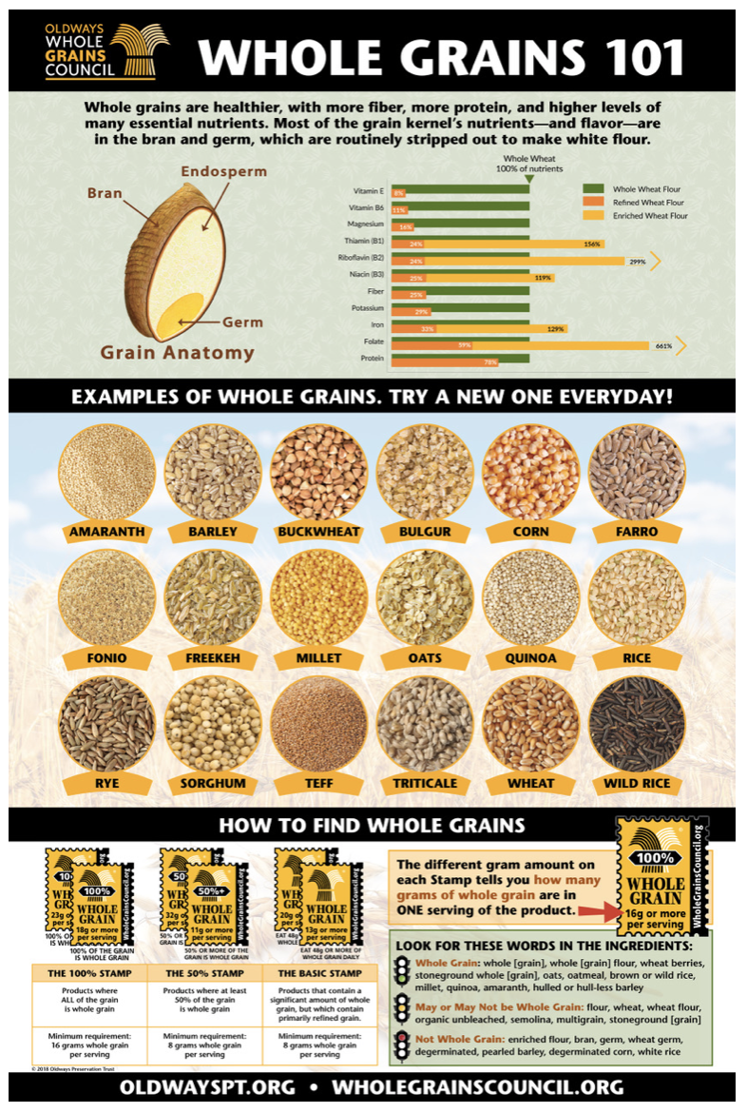
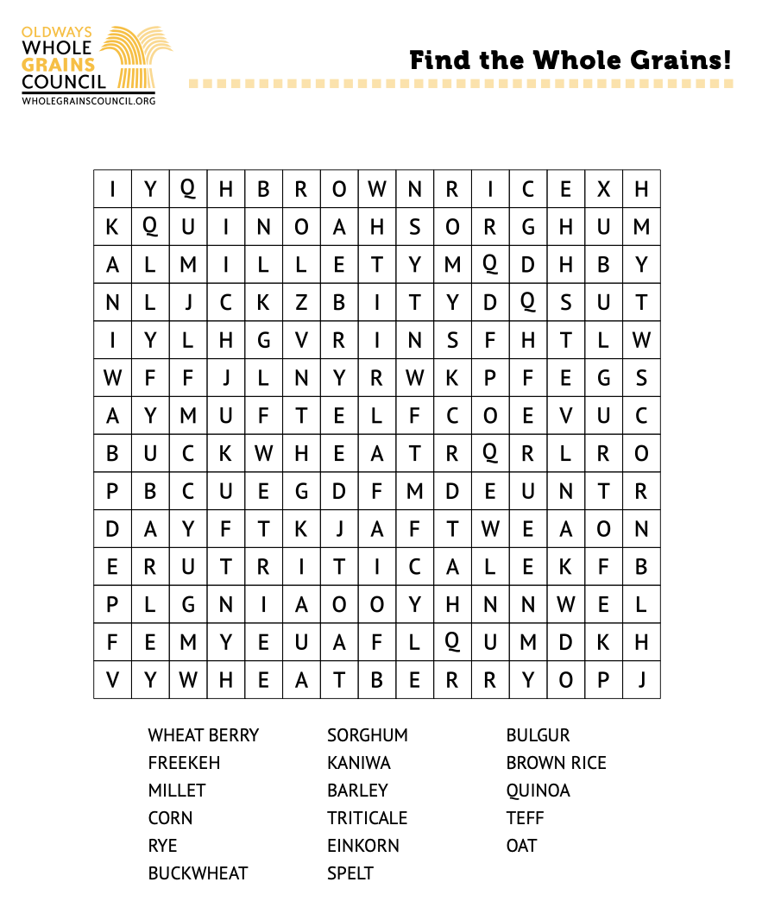
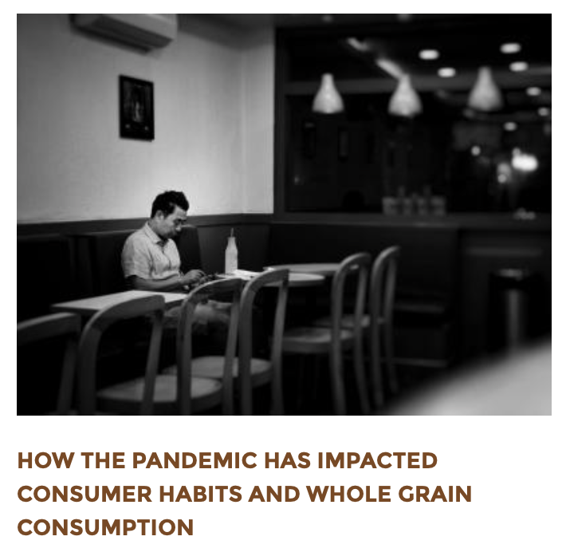
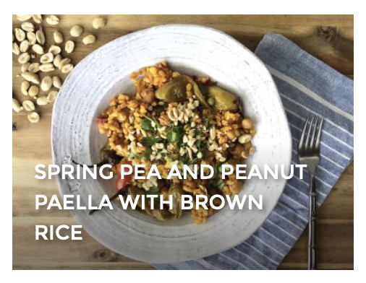
Ongoing Outreach & Education
Resources & Handouts
Blog Posts
Recipes
And Much More…
Online Cooking Classes
Whole Grain Webinars
Health Studies Database
Social Media Outreach
Posters, Stickers, Games, Worksheets, Lesson Plans
Whole Grain Hotline
Whole Grain Conferences
Media Kits & Interviews

Slide 6
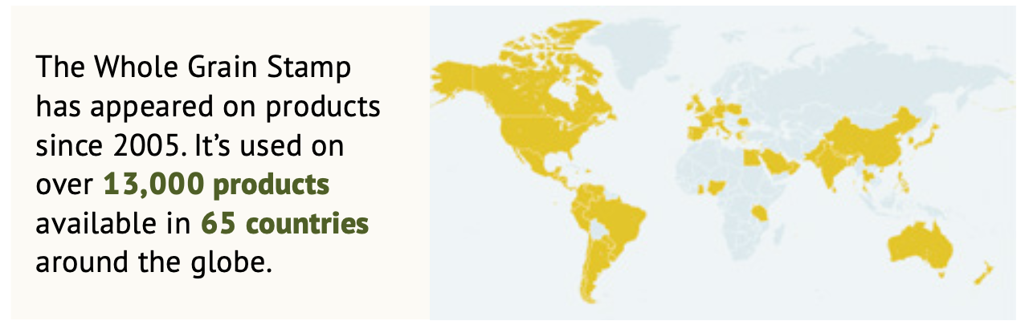
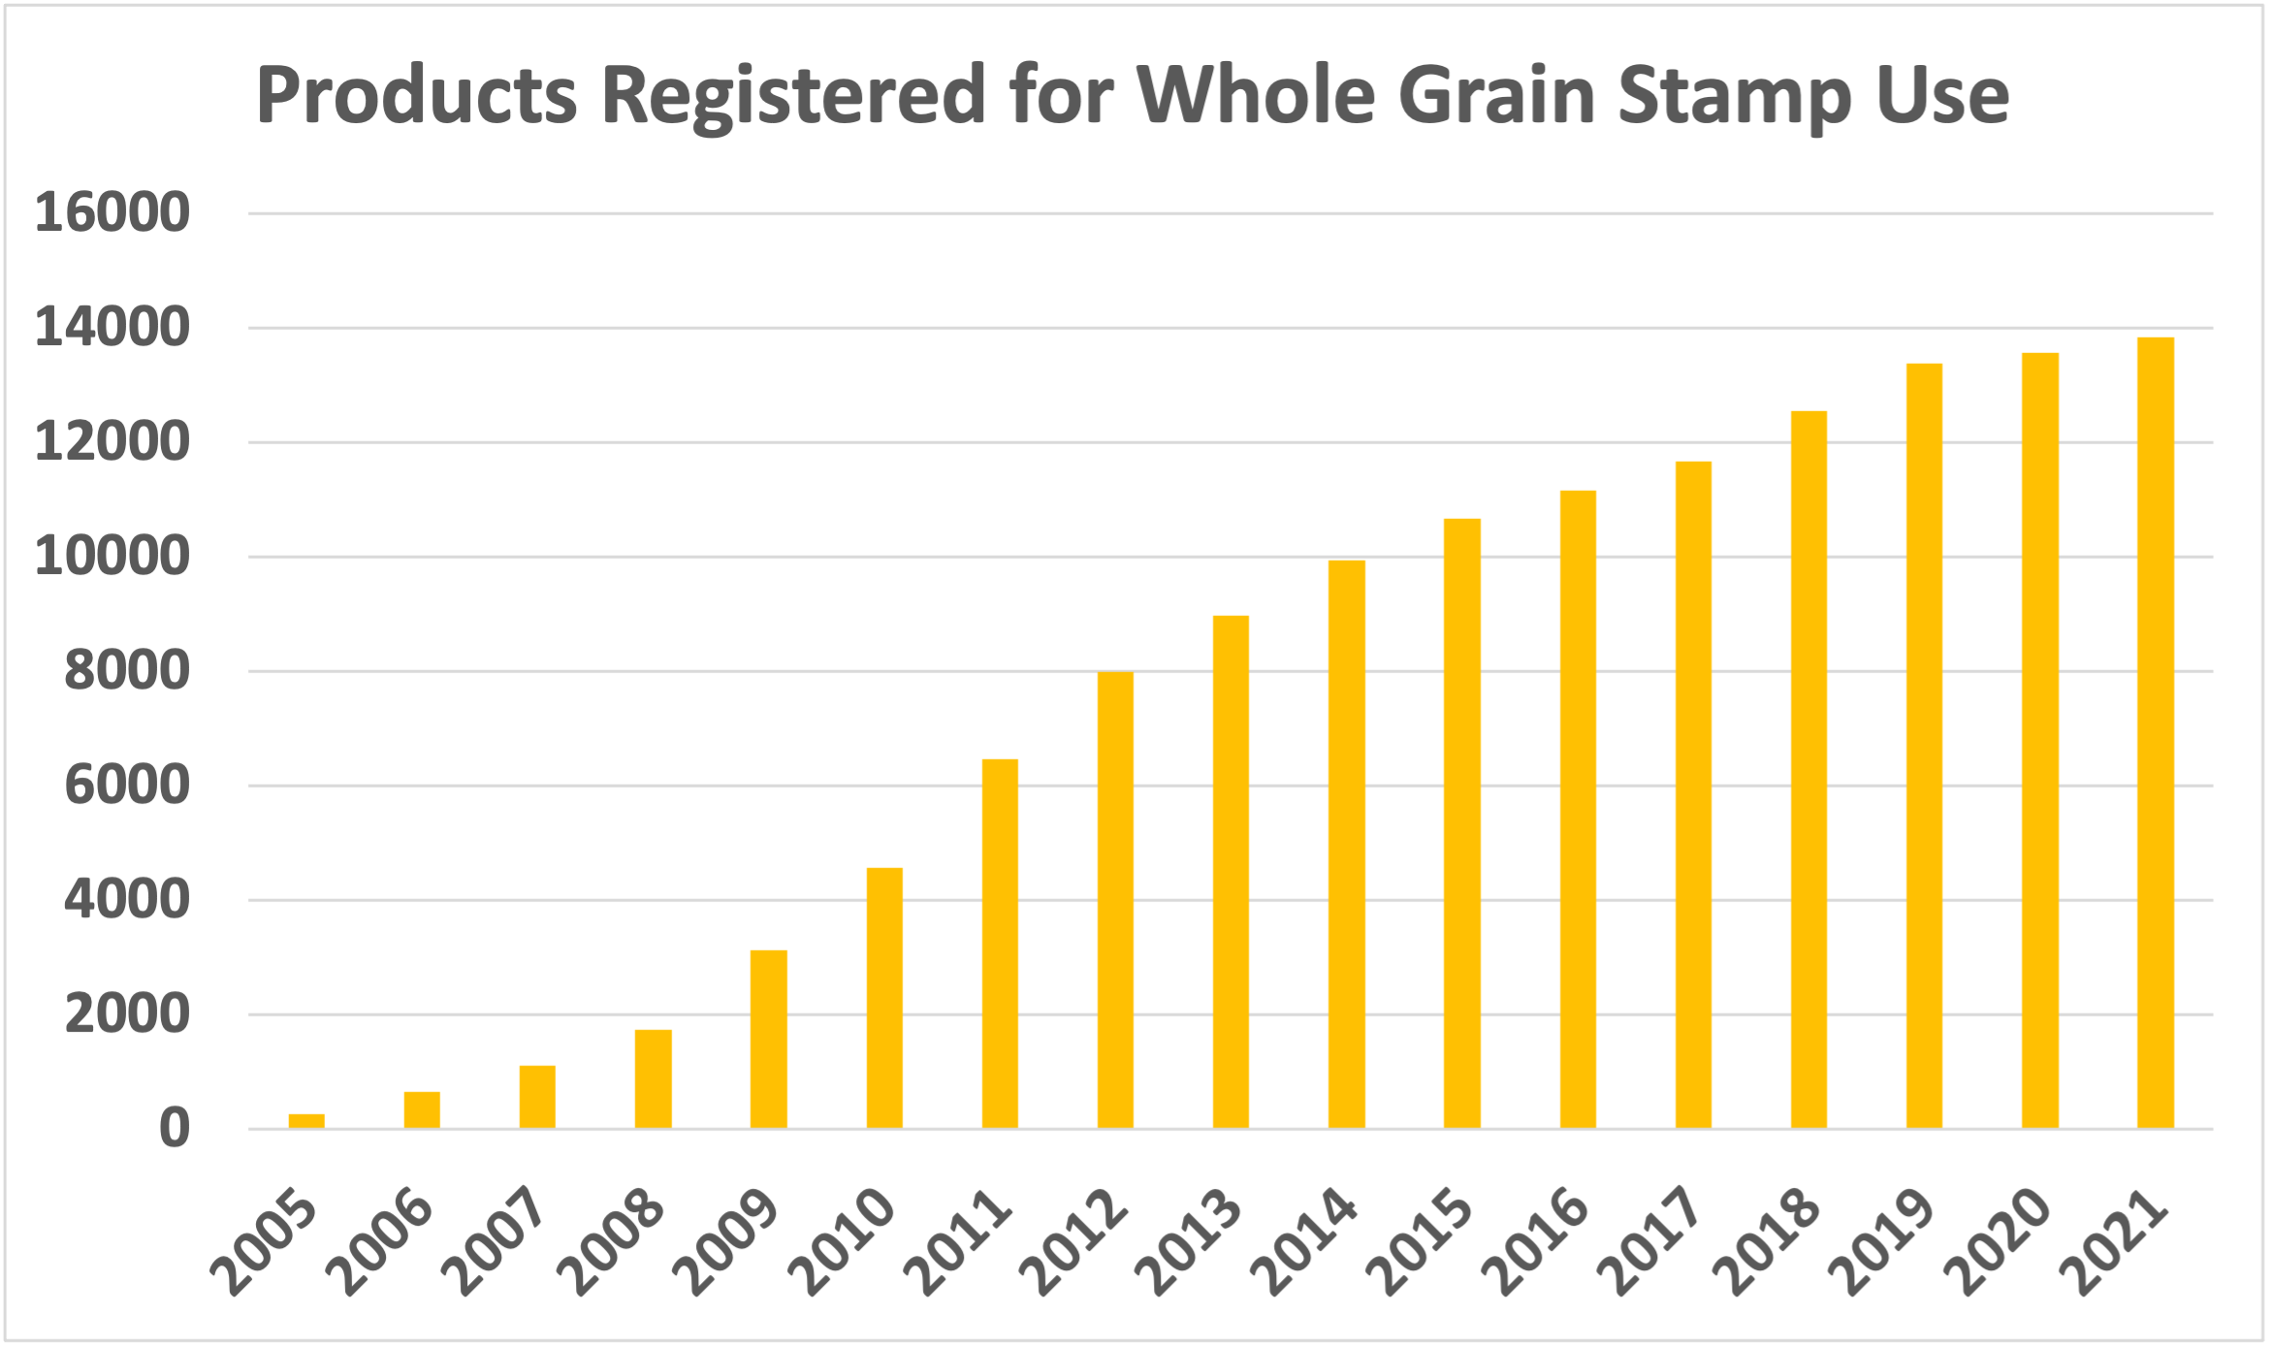
Importance of Clear and Consistent Labeling
The Whole Grain Stamp
ALL grain is whole grain
Minimum of 16g whole grain per serving
At least 50% of grain is whole grain
Minimum of 8g whole grain per serving
More refined grain than whole grain
Minimum of 8g whole grain per serving

Slide 7
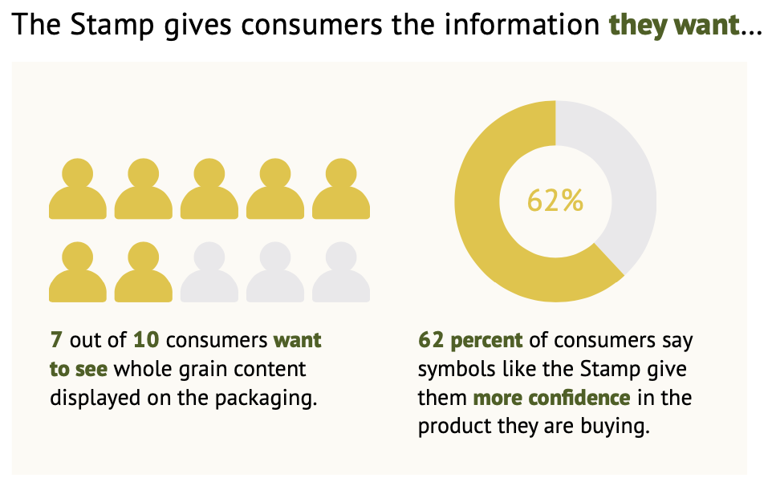
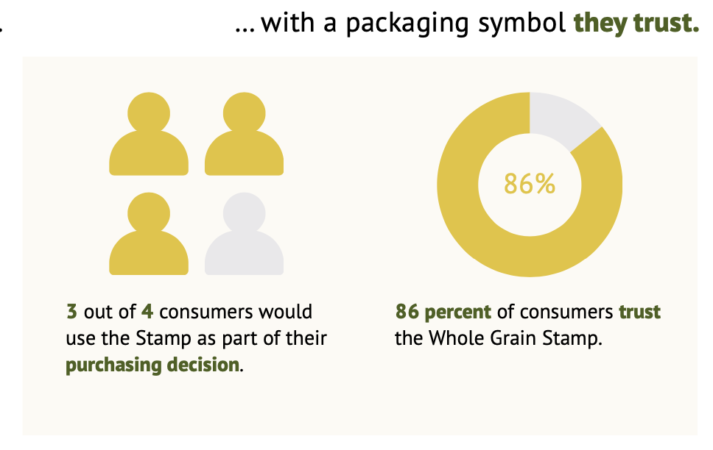
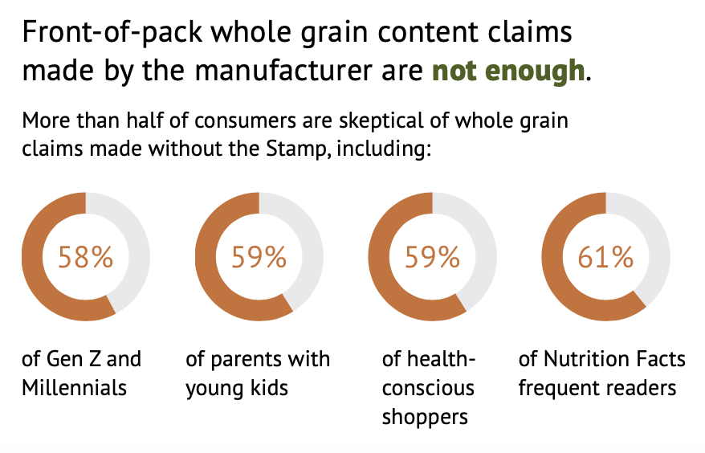
Survey Data Supports Use of Third-Party Packaging Symbols

Slide 8
Common Grain Myths & How to Bust Them

Slide 9
Does “Modern Wheat” Have More Gluten?
Survey of 20th & 21st century wheats found that gluten content of wheat has NOT increased (Kasarda, 2013)
Analysis of more than 200 wheat lines from 18th century through modern times found (Shewry, 2020):
  Decrease in some minerals (iron, zinc, magnesium) over time
  Small increase in fiber over time
  Increased starch and decreased protein over time (note: gluten is formed by proteins)
  Decrease in the gliadin:glutenin ratio, indicating a decrease in celiac disease antigens in modern wheat
  No increases in proteins known to trigger adverse reactions

Slide 10
Do Whole Grains Make You Gain Weight?
Weight problems are almost never the fault of one food; it is the overall diet pattern that matters
Study of a sandwich made with whole grain bread and real cheese compared to a sandwich on white bread with a processed cheese product (matched for calories, matched for ratio of bread to cheese)
  Participants burned 50% more calories digesting the whole grain sandwich (Barr, 2010)
6-week RCT of 81 adults: 1 whole grain group, 1 refined grain group, all other foods the same
  Whole grain group significantly improved metabolism (Karl, 2017)
  Whole grain group had significantly higher concentrations of “good” gut microbes (Vanegas, 2017)

Slide 11
Should you go gluten-free?
In a study with 1,312 “gluten-sensitive” adults (Molina-Infante, 2017)
  16% of patients had gluten-specific symptoms on gluten-containing diet
  40% had similar or increased symptoms on gluten-free diet.
Avoiding gluten-containing foods may increase risk for heart disease (Lebwohl, 2017)
Gluten-free ≠ Grain-free; most whole grains are naturally gluten-free
Gluten-Free Grains
Amaranth
Buckwheat
Corn
Oats***
Millet
Quinoa
Rice
Sorghum
Teff
***Check for cross-contamination

Slide 12
Should you go grain-free?
People who avoid grains tend to be less healthy (more likely to be overweight/obese, eat fewer fruits and vegetables, and less fiber) (Fayet-Moore, 2017)
Carbohydrates are the most readily available fuel for athletes during exercise (Burke, 2017)
Shifting away from grain foods (towards animal foods) puts a larger burden on environment (Mekonnen, 2012)
Grain-free or very low-carb diets may be popular with those looking to lose weight, however it is important to maintain a balanced approach

Slide 13
Whole Grain Communication Strategies

Slide 14
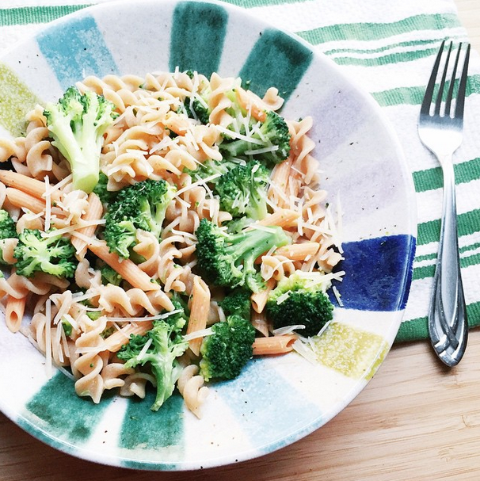
Tailor Messaging to Your Audience
For Confused Consumers: Getting your recommended whole grains is easy; look for the Whole Grain Stamp (or local equivalent) & the word ‘whole’ on ingredients labels
For Budget Conscious: Brown rice, breakfast cereal, and whole wheat pasta are all affordable whole grain options
For Concerned Cooks: Whole grains are easy to prepare; many ready-to-eat whole grain products are available; flavors range from mild to strong (so there’s something for everyone!)
Kelly Toups

Slide 15
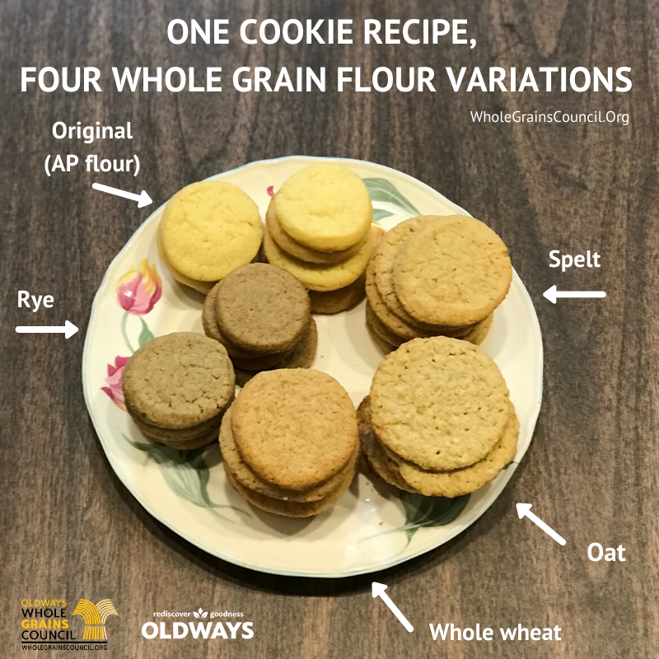
Tailor Messaging to Your Audience
For Foodies: Whole grains (esp. ancient grains) add rich flavors, colors, textures
For Athletes: Whole grains are a smart way to carb-load, and can pack a protein punch
For Environmentalists: Grains require less water per calorie than nearly any other crop; keeping the bran & germ of the grain helps cut down on waste

Slide 16
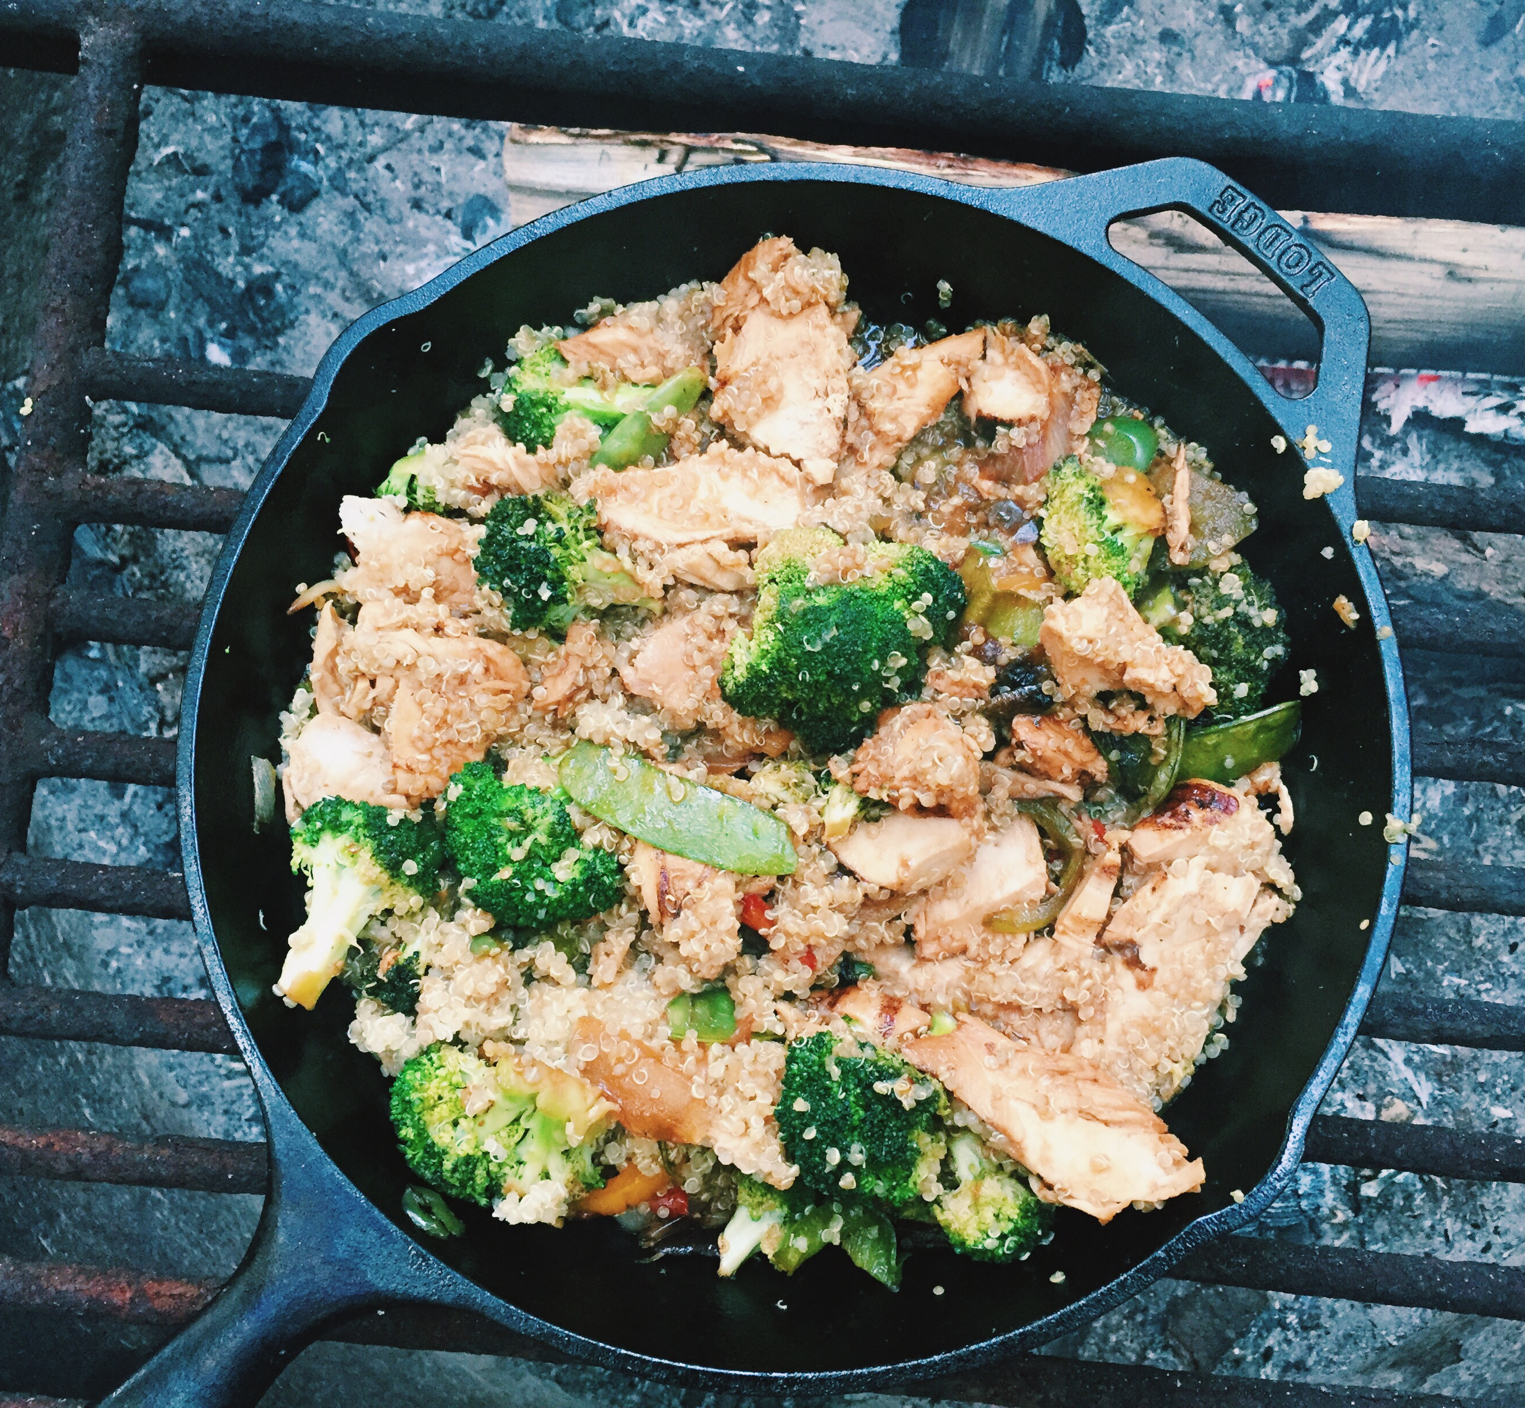
Tailor Messaging to Your Audience
For Gluten-Free: Gluten-free doesn’t mean grain-free; many whole grains ARE gluten-free
For Weight Watchers: Avoiding grains is not sustainable in the long term; not all weight-loss strategies are healthy; people who eat whole grains tend to weigh less
For Grain-Avoiders: Avoiding grains may have long-term health risks & environmental consequences
Kelly Toups

Slide 17
References
Barr, S. B., & Wright, J. C. (2010). Postprandial energy expenditure in whole-food and processed-food meals: implications for daily energy expenditure. Food & nutrition research, 54, 10.3402/fnr.v54i0.5144. https://doi.org/10.3402/fnr.v54i0.5144
Burke, L. M., Ross, M. L., Garvican-Lewis, L. A., Welvaert, M., Heikura, I. A., Forbes, S. G., Mirtschin, J. G., Cato, L. E., Strobel, N., Sharma, A. P., & Hawley, J. A. (2017). Low carbohydrate, high fat diet impairs exercise economy and negates the performance benefit from intensified training in elite race walkers. The Journal of physiology, 595(9), 2785–2807. https://doi.org/10.1113/JP273230
Fayet-Moore, F., Petocz, P., McConnell, A., Tuck, K., & Mansour, M. (2017). The Cross-Sectional Association between Consumption of the Recommended Five Food Group "Grain (Cereal)", Dietary Fibre and Anthropometric Measures among Australian Adults. Nutrients, 9(2), 157. https://doi.org/10.3390/nu9020157
Karl, J. P., Meydani, M., Barnett, J. B., Vanegas, S. M., Goldin, B., Kane, A., Rasmussen, H., Saltzman, E., Vangay, P., Knights, D., Chen, C. O., Das, S. K., Jonnalagadda, S. S., Meydani, S. N., & Roberts, S. B. (2017). Substituting whole grains for refined grains in a 6-wk randomized trial favorably affects energy-balance metrics in healthy men and postmenopausal women. The American journal of clinical nutrition, 105(3), 589–599. https://doi.org/10.3945/ajcn.116.139683
Kasarda D. D. (2013). Can an increase in celiac disease be attributed to an increase in the gluten content of wheat as a consequence of wheat breeding?. Journal of agricultural and food chemistry, 61(6), 1155–1159. https://doi.org/10.1021/jf305122s
Lebwohl, B., Cao, Y., Zong, G., Hu, F. B., Green, P., Neugut, A. I., Rimm, E. B., Sampson, L., Dougherty, L. W., Giovannucci, E., Willett, W. C., Sun, Q., & Chan, A. T. (2017). Long term gluten consumption in adults without celiac disease and risk of coronary heart disease: prospective cohort study. BMJ (Clinical research ed.), 357, j1892. https://doi.org/10.1136/bmj.j1892
Mekonnen, M.M., Hoekstra, A.Y. A (2012). Global Assessment of the Water Footprint of Farm Animal Products. Ecosystems 15, 401–415. https://doi.org/10.1007/s10021-011-9517-8
Molina-Infante, J., & Carroccio, A. (2017). Suspected Nonceliac Gluten Sensitivity Confirmed in Few Patients After Gluten Challenge in Double-Blind, Placebo-Controlled Trials. Clinical gastroenterology and hepatology : the official clinical practice journal of the American Gastroenterological Association, 15(3), 339–348. https://doi.org/10.1016/j.cgh.2016.08.007
Shewry, P. R., Hassall, K. L., Grausgruber, H., Andersson, A. A. M, Lampi, A.‐M., Piironen, V., Rakszegi, M., Ward, J. L., Lovegrove, A. (2020). Do modern types of wheat have lower quality for human health? Nutrition Bulletin, 45 (4), 362-373. https://doi.org/10.1111/nbu.12461
Vanegas, S. M., Meydani, M., Barnett, J. B., Goldin, B., Kane, A., Rasmussen, H., Brown, C., Vangay, P., Knights, D., Jonnalagadda, S., Koecher, K., Karl, J. P., Thomas, M., Dolnikowski, G., Li, L., Saltzman, E., Wu, D., & Meydani, S. N. (2017). Substituting whole grains for refined grains in a 6-wk randomized trial has a modest effect on gut microbiota and immune and inflammatory markers of healthy adults. The American journal of clinical nutrition, 105(3), 635–650. https://doi.org/10.3945/ajcn.116.146928

Slide 18
Thank You!
Caroline Sluyter
caroline@oldwayspt.org
https://wholegrainscouncil.org/

